Slide 1
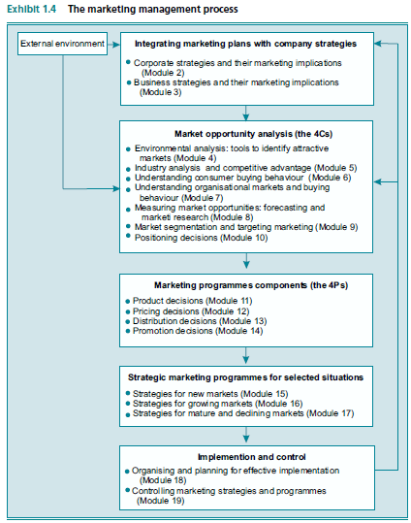

Slide 2
Part II: Opportunity Analysis
Module 4 Environmental Analysis: Tools to Identify Attractive Markets
Module 5 Industry Analysis and Competitive Advantage
Module 6 Understanding Consumer Buying Behaviour
Module 7 Understanding Organisational Markets and Buying Behaviour
Module 8 Measuring Market Opportunities: Forecasting and Market Research
Module 9 Market Segmentation and Target Marketing
Module 10 Positioning

Slide 3

4. Environmental Analysis: Tools to Identify Attractive Markets
Business Casual
Casual wear even in business became fashion
Many manufacturers closed entirely
Casual conversion
Moss tailored cloths changed to casual wear
Back again
Moss and others got back to formal after laying off acts
Does it really matter whether we swim upstream or downstream?
How can we be sure we’ve identified and understood the key trends?
How does macro trend analysis help in assessing markets and in making marketing decisions?

Slide 4
4.1 Swimming Upstream or Downstream: An Important Strategic Choice
Normally downstream, you have to adapt
Important to understand the trends of socio-cultural, demographic, and physical environments
The other three are the political/legal, economic, and technological components in Module 5.

Slide 5
4.2 Macro Trend Analysis: A Framework for Assessing Market Attractiveness
Demographic
Economical
Physical
Technology
Legal/ Political
Socio-Cultural

Slide 6
4.2.1 The Demographic Environment
Age% per region
Population distribution
AIDS effect
Education levels
Large Cities
… etc.

Slide 7
4.2.1.1 Implications of Demographic Trends for Market Attractiveness
Aging
Houses, in-home services
Asian countries rise up
Capital goods from US and EU
Minorities
Tailored products

Slide 8
4.2.2 The Sociocultural Environment
Values
Attitudes
General Bahavoiur
Slow to change, slower than demographic
Changes from place to place, UK homes are persons-centered and in Japan they are family-centered

Slide 9
4.2.2.1 Implications of Sociocultural Trends for Market Attractiveness
Better Life style
Low fat foods
Exercise
Natural foods

Slide 10
4.2.3 The Economic Environment
GDP
Per Capita (per person)
Calculated After inflation so PPP is necessary to be used
PPP
Basic basket of goods with $
Even it level-up the GDP of poor, but gap still big
Global Domestic Production
Purchase Power Parity, to compensate inflation effect

Slide 11
4.2.3.1 International Trade
Reducing import/export tariffs
Instant marketing as a result
Setting common production standards
Currency value play a role here

Slide 12
4.2.3.2 Implications of Economic Trends for Market Attractiveness
Demand
Capital Goods
Rate sensitive
Real-estate
Rate sensitive

Slide 13
4.2.4 The Political/Legal Environment
Stimulation
Tax Concessions
Threats
Domestication
Expropriation
Confiscation
Tariff Protection

Slide 14
4.2.4.1 Government Regulation
NO
Stifle innovation
Cripple the economy
YES
Food and drugs,
Adhere to regulations at less cost

Slide 15
4.2.4.2 Government Deregulation
Overregulation
Protects inefficiencies, restricts entry by new competitors, and creates inflationary pressures.
Deregulation
Changed the structure of the affected industries as well as lowered prices

Slide 16
4.2.4.3 Implications of Regulation and Deregulation for Market Attractiveness
Deregulation
Anti-monopoly
Regulation
Limiting Innovation

Slide 17
4.2.5 The Technological Environment
Technology
Metals
Time between idea and production minimized
Trend
Next 10 years will witness high progress
Specially in bioengineering and telecom
Bioengineering
Semi-conductors …. Etc.

Slide 18
4.2.5.1 Trends in Electronics/ Telecommunications
check-free banking
Death of the invoice
083 324 652 web pages
Low costs of communicating
Ticketless air travel.
Downloading music

Slide 19
4.2.5.2 Implications of Technological Trends for Market Attractiveness
Creating attractive new markets,
Impact on all aspects of marketing practice

Slide 20
4.2.6 The Physical Environment
Natural Resources are declining including water
Bottled water, purifying water, treating sewage water … etc.

Slide 21
4.2.6.1 Development of Green Products as a Response to Environmental Problems
New ways for heating and lighting
New energy sources
Phosphate-free detergents
Recycled motor oil
Organic fertilisers

Slide 22
4.2.6.2 Implications of Trends in the Physical Environment for Market Attractiveness
Depletion of natural resources
Green products opportunity

Slide 23
4.3 Environmental Analysis Guides Marketing Decision Making
Prioritise trend categories
Identify, and then monitor, sources of relevant information
Anticipate impacts

Slide 24
4.3.1 Prioritising Trend Categories
Food marketers study demographic
Real estate investors closely monitor economic trends
Venture capitalists and high-tech entrepreneurs watch technology
Female’s wear athletes have become a growing market,

Slide 25
4.3.2 Information Sources and Outputs of Macro Trend Analysis
Press
Internet
Contacts
Trade associations
Trade magazines
governments
Quantitative data provides evidence of the market’s size and growth rate
Qualitative data includes factors that influences these figures in the future

Slide 26
4.3.3 Anticipating and Responding to Environmental Change
opportunity/threat matrix
Reactive
Or Proactive

Slide 27
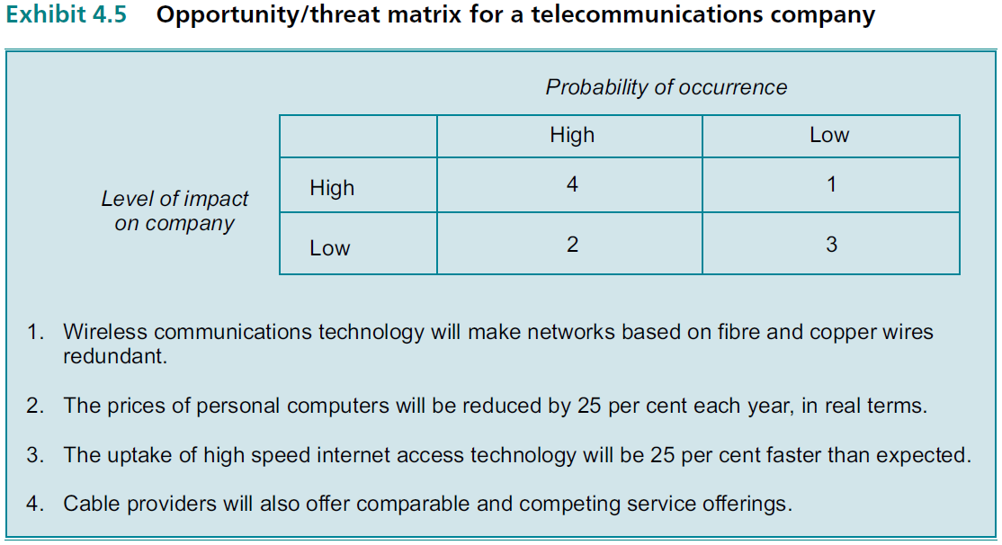
4.3.3.1 Impact and Timing of Event

